Slide 1
Software engineering Foundation Recap week 2

Slide 2
Software Engineering Track – Learning Goals
OO Analysis
UML
Modeling
UX
User Interaction
Core Java
OO Design

Slide 3
Software Engineering Track – Case(s)
Week 2
Class model
Week 1
Wrap-up
OCA
Team 4
Side-case
Team 4

Slide 4
Agenda Dag 5
09:30 – 11:45: UX Design
11:45 – 12:30: Lunch
12:30 – 14:30: Class model week 2 implemented (with basic tests!)
14:30 – 15:00: Demo
15:00 – 16:00: Continue implementation week 2
16:00 – 16:30: Retrospective & Wrap-up

Slide 5
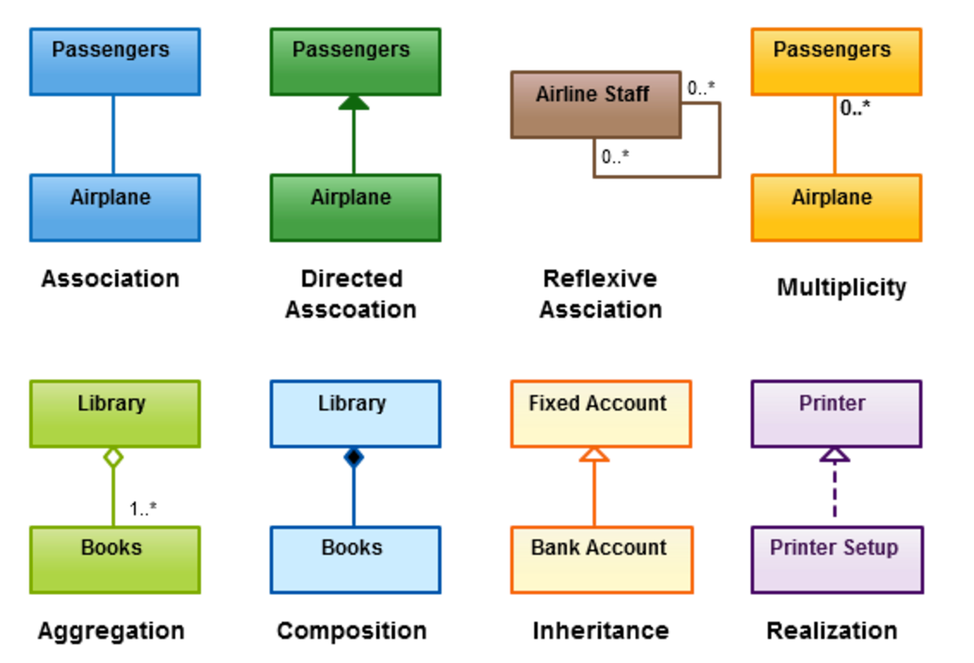
Recap: Class Models
Designing an application model
Identifying objects
Defining relationships
Dependencies
Associations
Inheritance
Interfaces
Aggregations
Compositions
Implementing an application model
Classes & Interfaces
Attributes & Properties
Extends & Implements

Slide 6

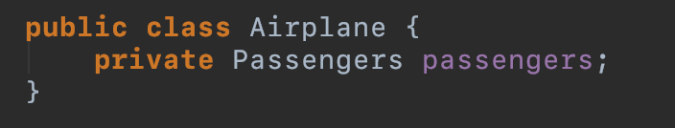
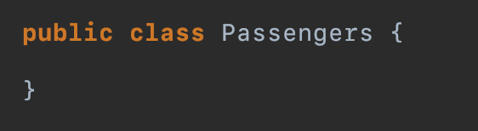
Recap: Implementing Class Models
Association

Slide 7
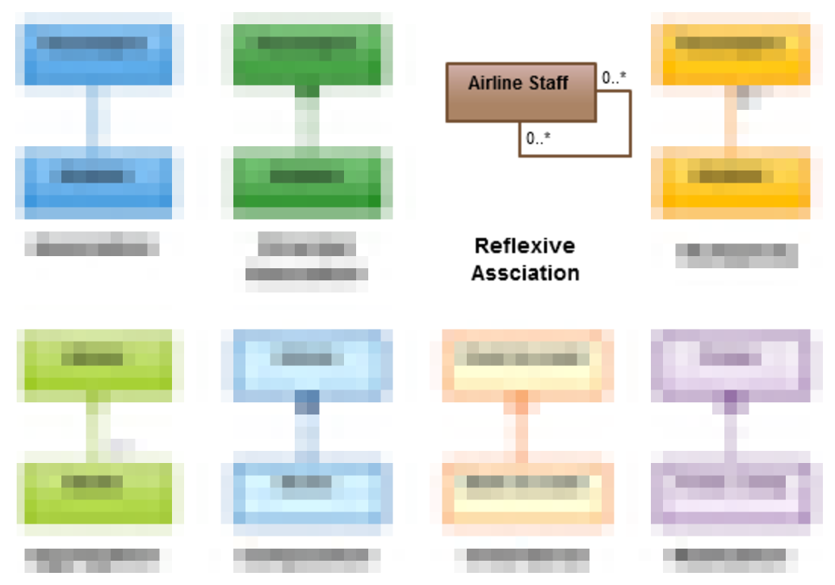
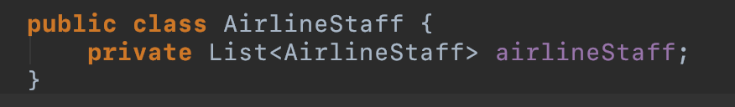
Recap: Implementing Class Models
Self-Association (Recursive)

Slide 8
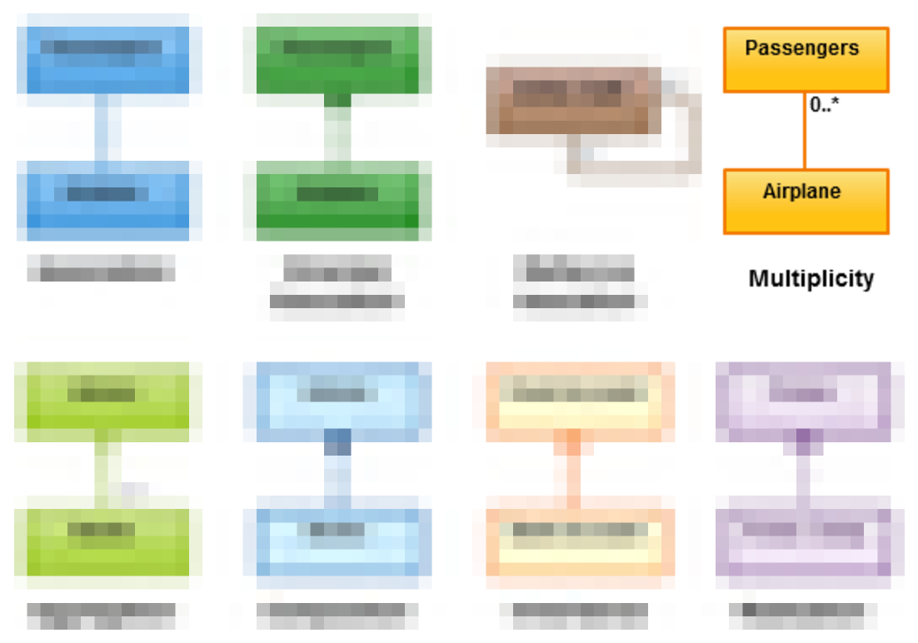
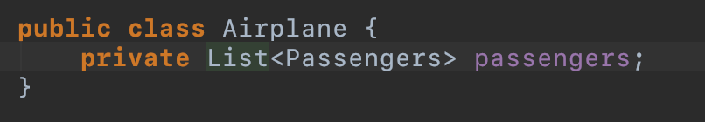
Recap: Implementing Class Models
Multiplicity/Cardinality

Slide 9
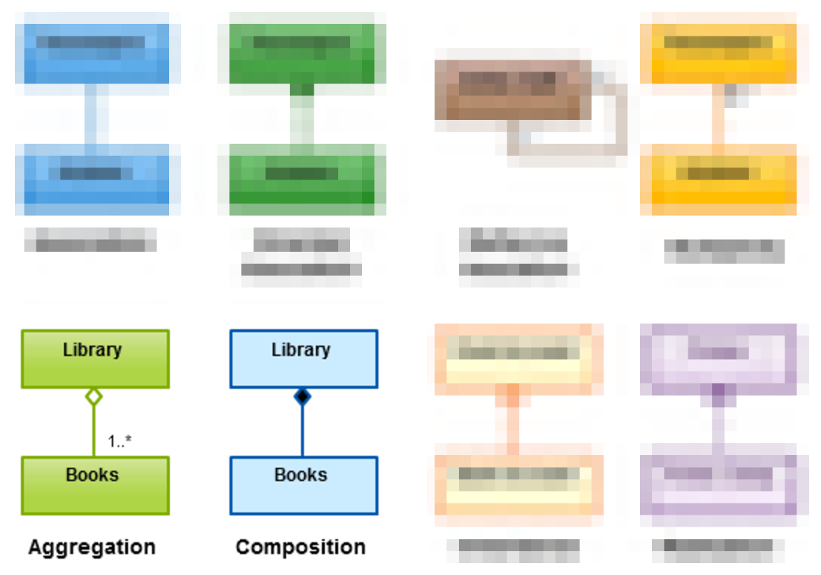
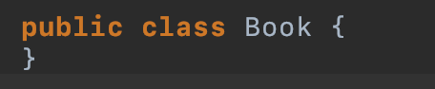
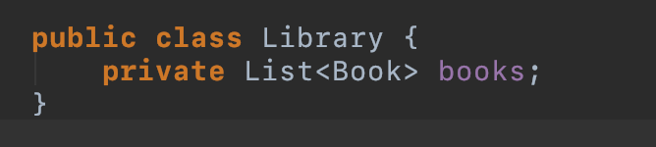
Recap: Implementing Class Models
Aggregation/Composition

Slide 10
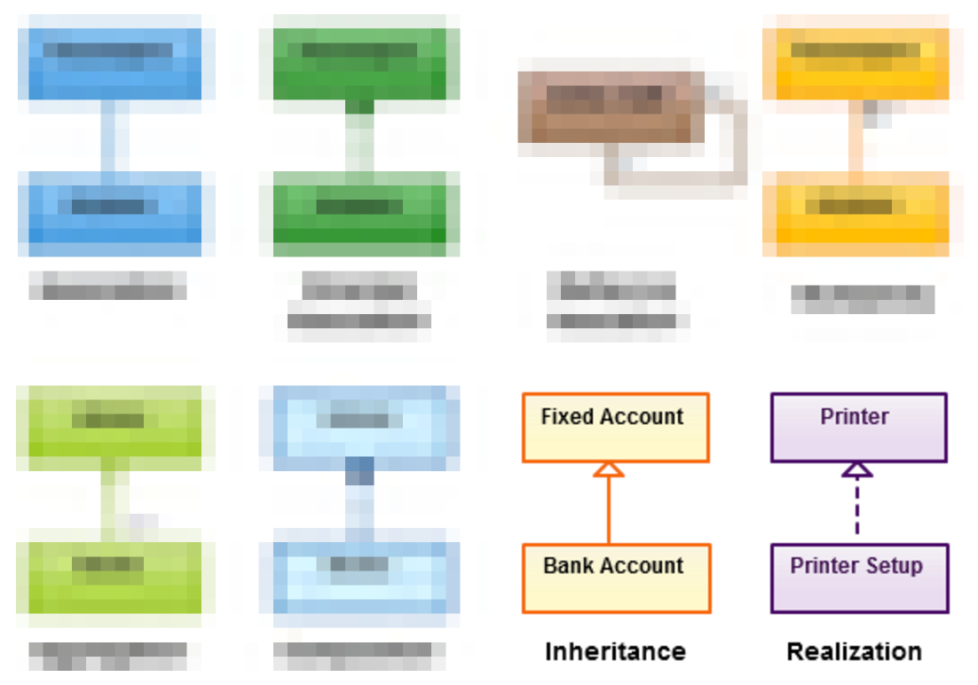
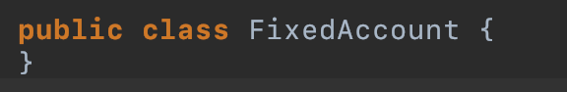
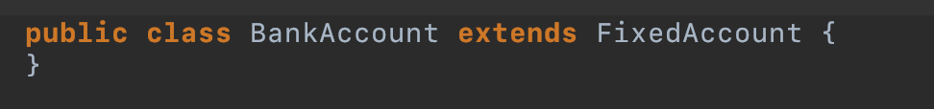
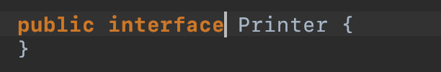
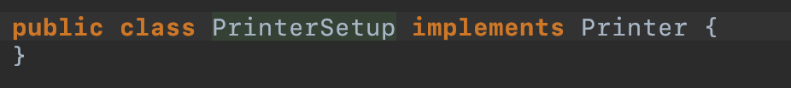
Recap: Implementing Class Models
Aggregation/Composition

Slide 11
Retrospective
Look back at the last sprint with regards to the process and relation between team members
Identify possible improvements
Define action points and make a plan how to implement them

